Slide 1

CGB1201 – DATABASE MANAGEMENT SYSTEMS
Department of Artificial Intelligence and Data Science
Academic Year: 2025 (Even Semester)
Register Number : 2303811724321077
Name : NETHAJI J
Year : II
Semester :IV
Section : B
Date :29-05-2025
CGB1221-DATABASE MANAGEMENT SYSTEMS

Slide 2
Title of the Project
BOOKSTORE MANAGEMENT SYSTEM
CGB1221-DATABASE MANAGEMENT SYSTEMS

Slide 3
Presentation Overview
Problem Identification
Objective
Proposed system
Block diagram of proposed system
Database Concepts
Modules Description
Module Implementation
Files
Conclusion
3
CGB1221-DATABASE MANAGEMENT SYSTEMS

Slide 4
Problem Identification
Manual book sales and inventory management are time-consuming and error-prone.
Difficult to track sales, stock levels, and customer data efficiently.
Lack of centralized and searchable book records.
Inefficient customer service due to slow record retrieval
CGB1221-DATABASE MANAGEMENT SYSTEMS

Slide 5
Objective
Develop a digital system for managing book inventory and sales.
Provide login-based secure access for staff/admin.
Enable features like add/update/delete/search books.
Generate reports on stock levels and sales.
Create a user-friendly interface for bookstore operations.
CGB1221-DATABASE MANAGEMENT SYSTEMS

Slide 6
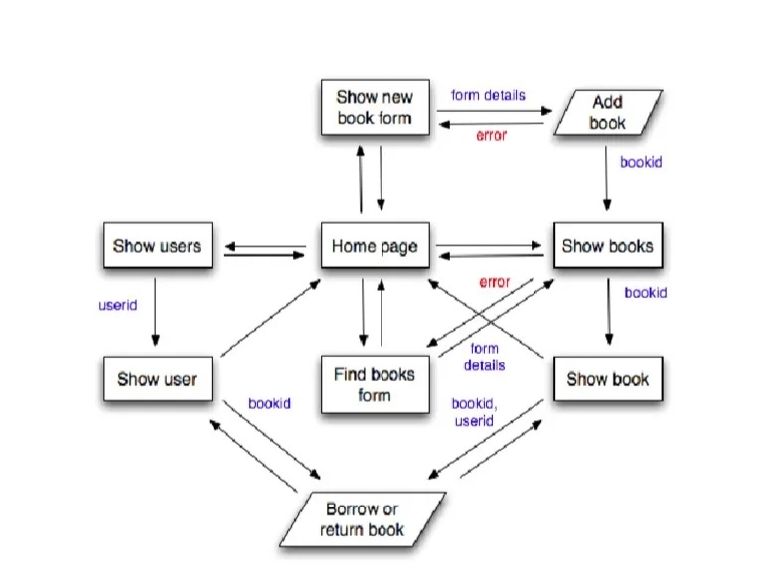
Proposed Architecture
CGB1221-DATABASE MANAGEMENT SYSTEMS

Slide 7
Concepts Used
Frontend: HTML, CSS
Backend: PHP
Database: MySQL
Security: Session-based login system
Platform: XAMPP / Localhost environment
CGB1221-DATABASE MANAGEMENT SYSTEMS

Slide 8
List of Modules
User Authentication
Bookstore Management
Add/Update/Delete Books
Manage Sales & Transactions
Purchases Modules
CGB1221-DATABASE MANAGEMENT SYSTEMS

Slide 9
Module Implementation
User Authentication Module
Register/Login system
Session-based security
Handles invalid login attempts
Logout functionality
9
CGB1221-DATABASE MANAGEMENT SYSTEMS

Slide 10
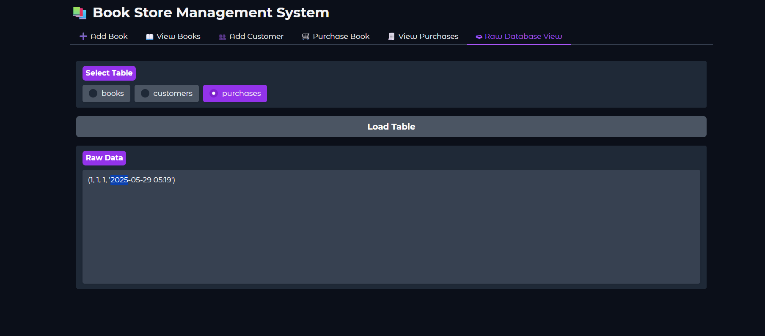
Module Implementation
10
CGB1221-DATABASE MANAGEMENT SYSTEMS

Slide 11
Module Implementation
Bookstore Management Module
Manages book records including title, author, price, and stock.
Handles customer details and purchase history.
Processes sales and generates bills efficiently.
Tracks inventory and provides insightful reports
11
CGB1221-DATABASE MANAGEMENT SYSTEMS

Slide 12
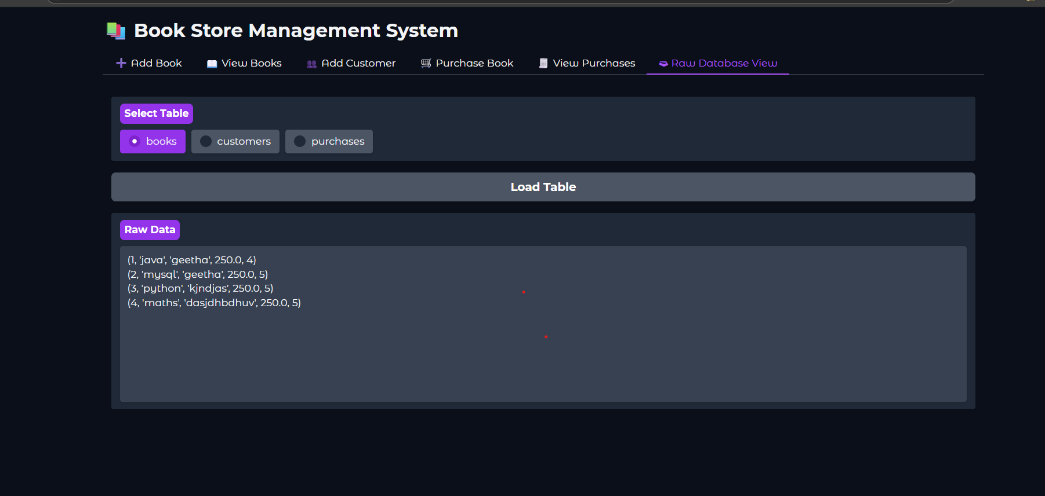
Module Implementation
12
CGB1221-DATABASE MANAGEMENT SYSTEMS

Slide 13
Module Implementation
Add Expense Module
Provides a form interface to input expense details:
Amount, Category, Date, Description
Validates inputs (e.g., amount must be numeric)
Saves expense data to the database under the logged-in user
Displays confirmation message after successful entry
Ensures data integrity with proper data types and validations
13
CGB1221-DATABASE MANAGEMENT SYSTEMS

Slide 14
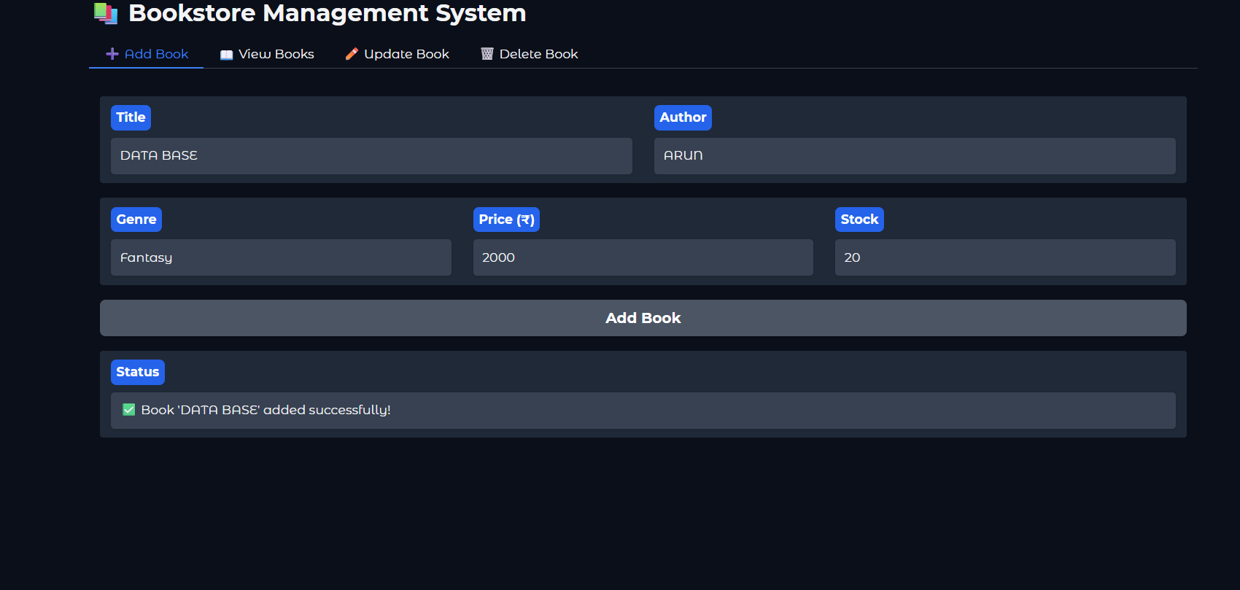
Module Implementation
14
CGB1221-DATABASE MANAGEMENT SYSTEMS

Slide 15
Module Implementation
Manage Sales & Transactions
Records each book sale with customer details.
Generates invoices and receipts instantly.
Applies discounts and promotional offers.
Tracks daily sales and payment history.
15
CGB1221-DATABASE MANAGEMENT SYSTEMS

Slide 16
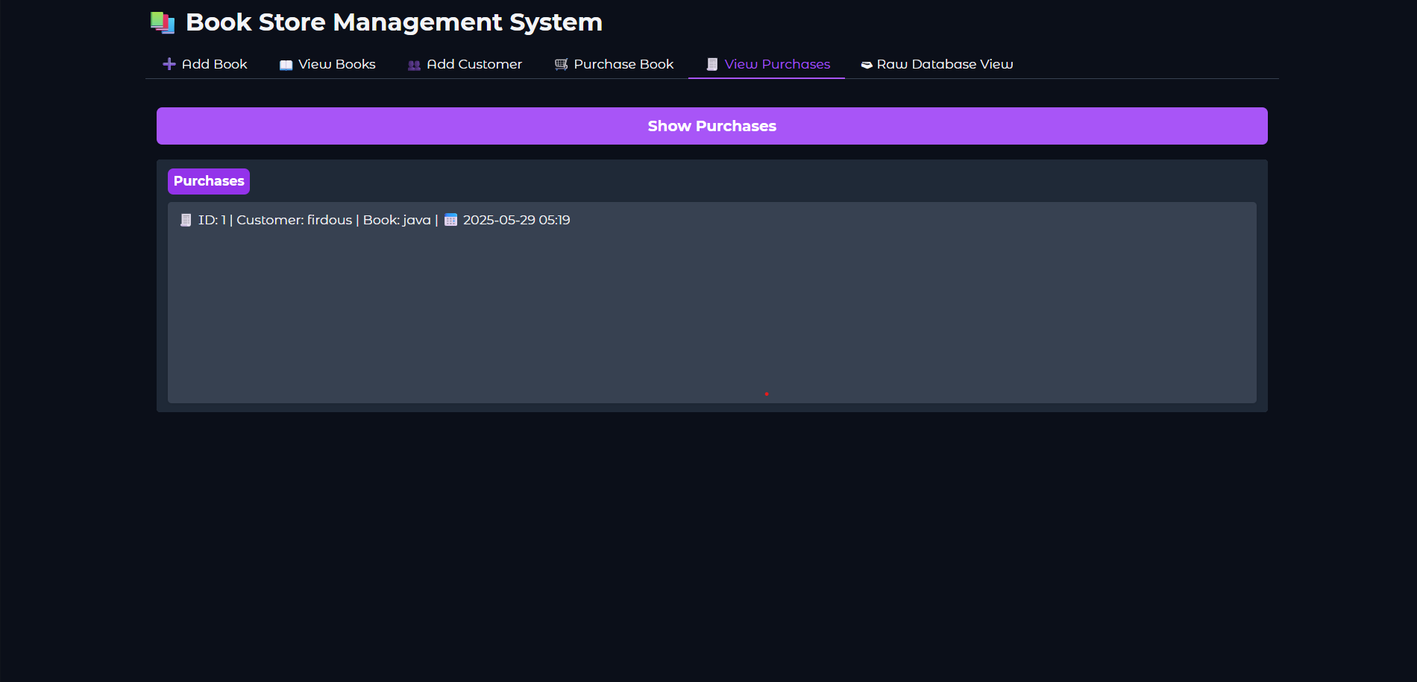
Module Implementation
16
CGB1221-DATABASE MANAGEMENT SYSTEMS

Slide 17
Module Implementation
Purchases Modules
Records new stock purchases from suppliers.
Updates book inventory automatically.
Manages supplier details and purchase history.
Tracks purchase costs and generates reports.
17
CGB1221-DATABASE MANAGEMENT SYSTEMS

Slide 18
Module Implementation
18
CGB1221-DATABASE MANAGEMENT SYSTEMS

Slide 19
Conclusion
The system simplifies book, customer, and sales management.
It improves accuracy and reduces manual workload.
Real-time tracking of inventory and transactions enhances efficiency.
Overall, it provides a reliable and user-friendly solution for bookstore operations.
19
CGB1221-DATABASE MANAGEMENT SYSTEMS

Slide 20
Thank You
CGB1221-DATABASE MANAGEMENT SYSTEMS

